Slide 1
Data Physicalisation
March 2023
This workshop was adapted from the content published by Dr. Samuel Huron et al in the Proceedings of the 2017 Conference on Designing Interactive Systems published here

Slide 2

“A data physicalization is a physical artifact whose geometry or material properties encode data.¹”
What is Data Physicalization?
1 https://datajournalism.com/read/longreads/lets-get-physical-how-to-represent-data-through-touch
Video: https://stans.cafe/project/project-of-all-the-people/

Slide 3
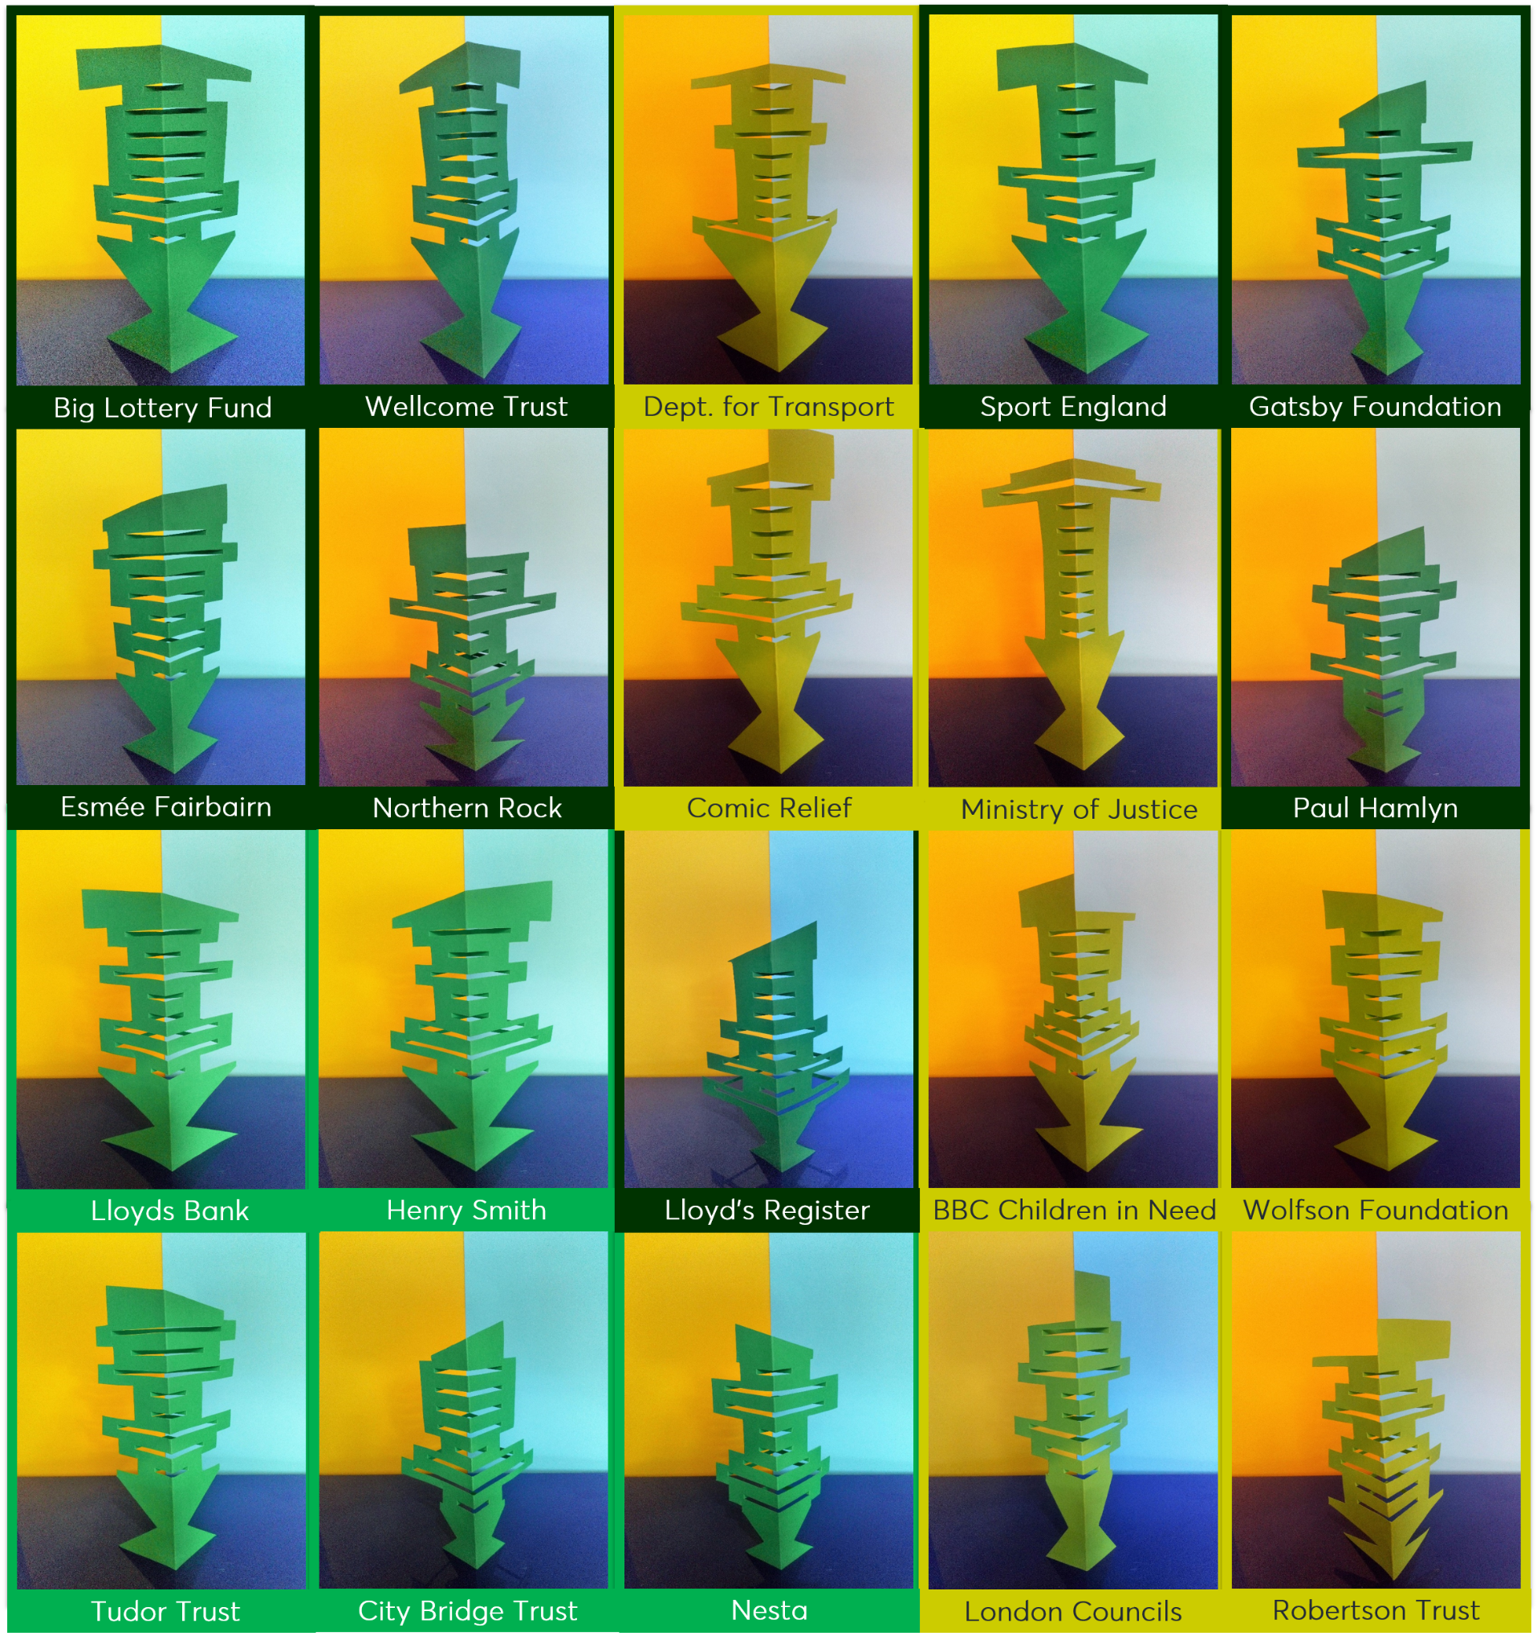
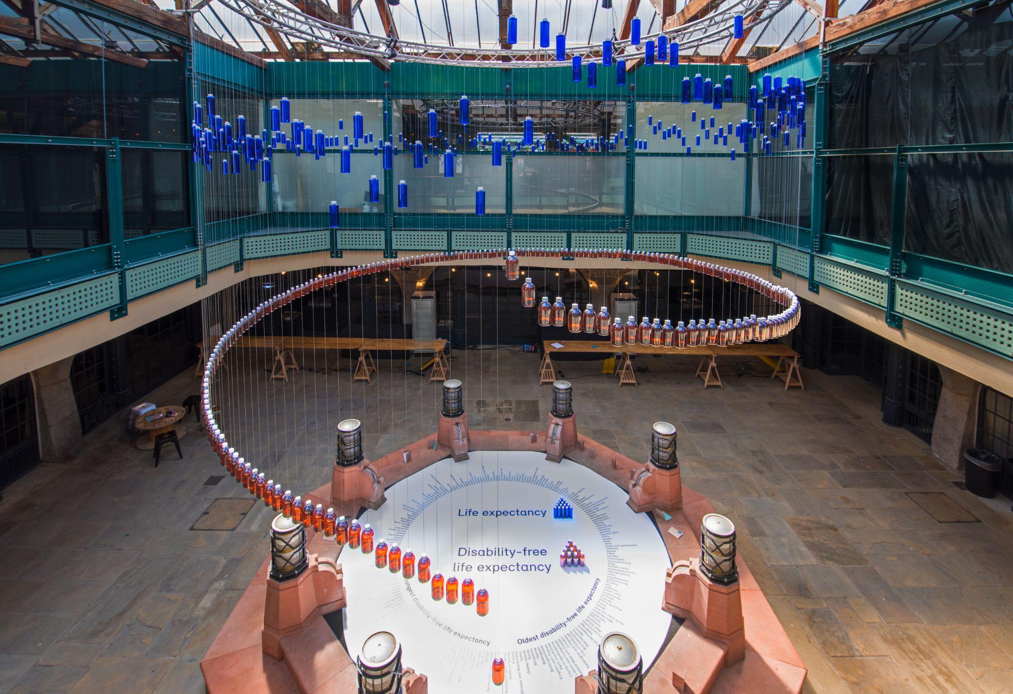
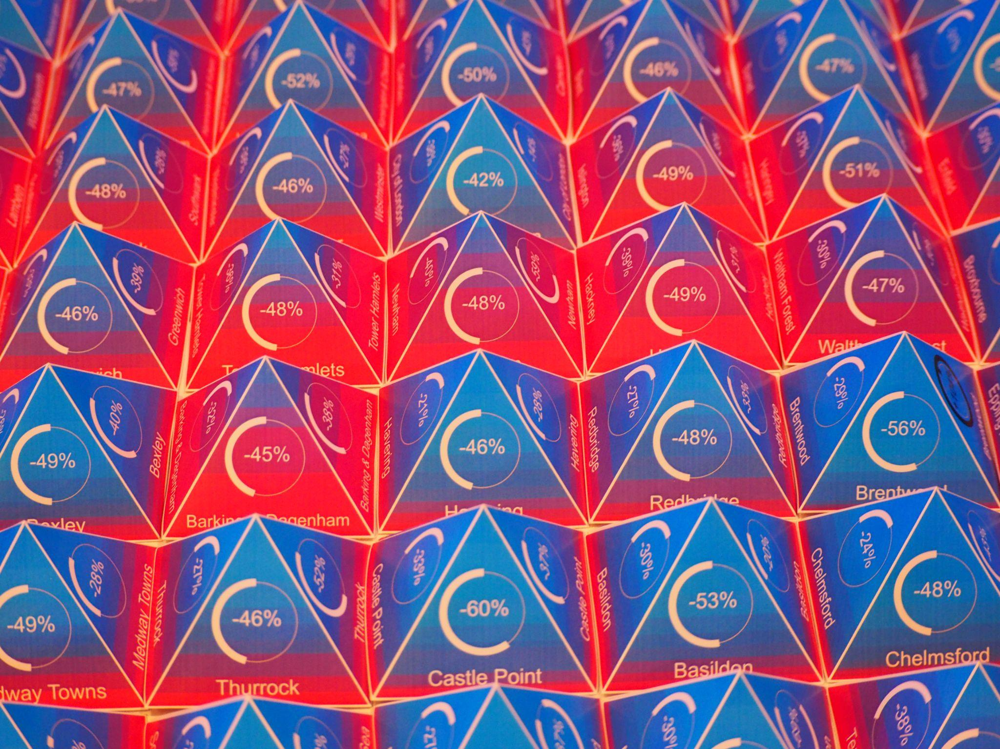
Why are we building physical data visualizations?
To get to know each other!
To learn a little more about a mission: we’ll be using mission-relevant datasets
To rethink how we communicate data-driven insights
To engage our creative brains!
Previous physical data viz @ Nesta

Slide 4
Instructions
In the group you are sat with, you will be building your own data physicalisation to represent a dataset that is core to one of Nesta’s Missions.
We will be passing out packets to your groups. The packet will contain:
Dataset: this is the dataset your group will be physicalizing
Persona Cards: these contain potential audiences for your physicalisation
Activity Cards: these contain a single descriptive word to evoke what you want the audience to get out of your physicalisation/how they will interact with it
Scenario Cards: these describe potential situations in which your audience is interacting with your physicalisation
As a group, you will choose one audience, activity, and scenario to frame your physicalisation. Depending on your choice, you may produce a standalone visualization or a demonstration requiring interaction. Keep in mind that you will only have 5 minutes to present your physicalisation and there will be a prize for the winner!
You may use any of the materials provided, or feel free to venture around the building and collect anything else you’d like to include or use (chairs, cups, books from the library….). Your visual will be evaluated against many different criteria (such as most inventive approach, most colourful, most environmental use of materials, etc.) so get creative!

Slide 5
Your group will be given one of the following datasets. We have summarised the data so that it is easier for you to work with. However, if you would like to spend more time exploring the full dataset and including additional variables you are welcome to do so.
A Fairer Start
Early Years Foundation Stage Profile
This dataset reports on teachers assessments of child development at age 5. The data shows variations in outcomes across geographies, demographics, and indicators of income levels.
Health Visitor Statistics
This dataset reports on the percentage of eligible children who actually receive various health visiting appointments throughout their early years.
A Sustainable Future
Home Retrofits
This dataset shows the typical capital cost, energy bill savings, CO2 savings and level of disruption for each measure in a typical home.
Carbon Emissions
The other group will receive a dataset showing the carbon emissions of various activities, including the operation of various household appliances.
A Healthy Life
Details of Purchases for Household Supplies
This dataset combines information from ‘purchases’ and ‘expenditure’ datasets. The ‘purchases’ dataset give the average quantity of food and drink purchased per person per week for each food and drink category. The ‘expenditure’ dataset give the average amount spent in pence per person per week on each type of food and drink.
Household Energy and Nutrient Intakes
The ‘nutrient intake’ dataset give the average nutrient intake (eg energy, carbohydrates, protein, fat, fibre, minerals and vitamins) from food and drink per person per day.

Slide 6
Schedule
Planning and building time (2 hours)
We recommend you spend the first 10-20 minutes discussing the audiences, activities, and scenarios before selecting which to build. Not all activities or scenarios will be appropriate for all audiences.
Sharing our physicalisations (30 minutes)
Each team will have 5 minutes to present their physicalisation to the rest of the group. Please cut out the cards you choose and paste them on your plaque, along with a title, to describe your physicalisation. Depending on your physicalisation, your presentation may or may not be interactive.

Slide 7
A few tips before you dive in!
Physical data viz are often good for showing scale
Give yourself time to find your story in the data
Keep the story simple!
Find a medium that reinforces your story
Think about how you’ll grab people’s attention (size / colour / novelty)
Think about how you’d like people to feel

Slide 8
Sharing our Physicalisations

Slide 9
Presenting your Data Physicalizations
Presentations!
If you haven’t already, please complete your plaque with the title of your physicalisation. Cut out the persona, scenario, and activity card that you chose and paste them on your plaque as a summary of your physicalisation.
Each team will have 5 minutes to present their physicalisation to the rest of the group.

Slide 10
Presenting your Data Physicalizations
Prizes!
You will have ~5-10 minutes to walk around the room and place your vote by putting your sticky dot on the plaque of your chosen data physicalization winner for each category. The categories are:
Most environmental use of materials - green dot
Most inventive approach - red dot
Best communicates a key Mission issue - yellow dot
Most engaging content-wise - blue dot

